Slide 1
Chapter 7 The Web 2.0 Environment and Social Networks

Slide 2
LEARNING OBJECTIVES
Understand the Web 2.0 revolution, social and business networks, and industry and market disruptors.
Understand the concept, structure, types, and issues of virtual communities.
Understand social networking and social network services sites.
Describe some of the major social networks.

Slide 3
LEARNING OBJECTIVES
Describe business-oriented and enterprise social networks.
Understand the commercial aspects of social networking.
Describe Web 2.0 entertainment.
Describe the potential of Web 3.0 and Web 4.0.

Slide 4
THE WEB 2.0 REVOLUTION, SOCIAL MEDIA, AND INDUSTRY DISRUPTORS
What is Web 2.0 ?
The popular term for advanced Internet technology and applications, including blogs, wikis, RSS, and social bookmarking. One of the most significant differences between Web 2.0 and the traditional World Wide Web is greater collaboration among Internet users and other users, content providers, and enterprises.
In summary:
Web 2.0 is the second generation of internet-based services that lets people collaborate and share information online in new ways such as social networking sites, wikis, communication tools and folksonomies.

Slide 5
THE WEB 2.0 REVOLUTION, SOCIAL MEDIA, AND INDUSTRY DISRUPTORS
REPRESENTATIVE CHARACTERISTICS OF WEB 2.0
The ability to tap into the collective intelligence of users
Data is made available in new or never-intended ways
Web 2.0 relies on user-generated and user-controlled content and data
The virtual elimination of software-upgrade cycles makes everything a work in progress and allows rapid prototyping

Slide 6
THE WEB 2.0 REVOLUTION, SOCIAL MEDIA, AND INDUSTRY DISRUPTORS
Users can access applications entirely through a browser
An architecture of participation encourages users to add value to the application
A major emphasis on social networks and computing
Strong support of information sharing and collaboration
Rapid and continuous creation of new business models

Slide 7
THE WEB 2.0 REVOLUTION, SOCIAL MEDIA, AND INDUSTRY DISRUPTORS
WEB 2.0 COMPANIES AND NEW BUSINESS MODELS
social media
The online platforms and tools that people use to share opinions, experiences, insights, perceptions, and various media, including photos, videos, and music, with each other.

Slide 8
THE WEB 2.0 REVOLUTION, SOCIAL MEDIA, AND INDUSTRY DISRUPTORS
Copyright © 2011 Pearson Education, Inc. Publishing as Prentice Hall
7-7
Example : Wikipedia
Free online collaborative encyclopedia
Potential new name “citizendium”
Potential competitor: Google’s “Knol”
Two Key problems:
Accuracy of contents
Invasion of privacy
Notes:
7

Slide 9
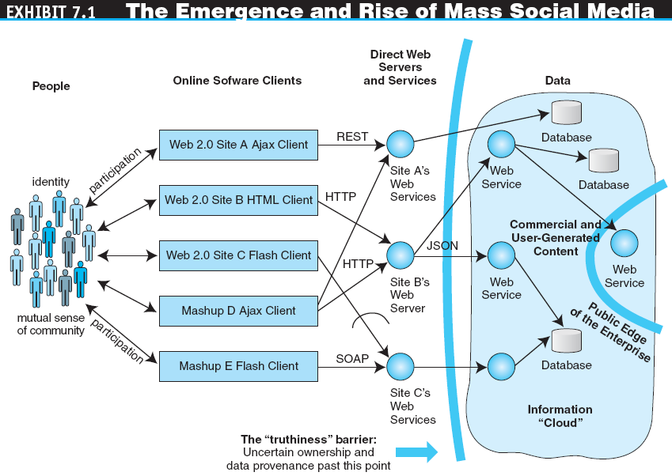

Slide 10
THE WEB 2.0 REVOLUTION, SOCIAL MEDIA, AND INDUSTRY DISRUPTORS
INDUSTRY AND MARKET DISRUPTORS
disruptors
Companies that introduce a significant change in their industries, thus causing a disruption in normal business operations.

Slide 11
VIRTUAL COMMUNITIES
virtual (Internet) community
A group of people with similar interests who interact with one another using the Internet.

Slide 12
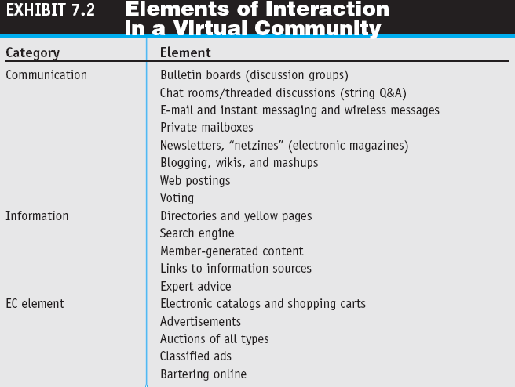

Slide 13
VIRTUAL COMMUNITIES
CHARACTERISTICS OF TRADITIONAL ONLINE COMMUNITIES AND THEIR CLASSIFICATION
Types of Communities
Public (e.g. facebook) Versus Private Communities
Internal and External Private Communities
Other Classifications of Virtual Communities

Slide 14
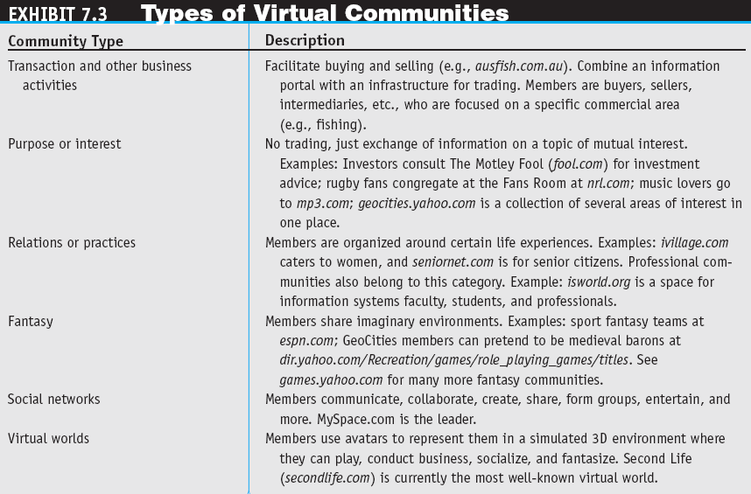

Slide 15
ONLINE SOCIAL NETWORKING: BASICS AND EXAMPLES
social networking
Social networks and activities conducted in social networks. It also includes activities conducted using Web 2.0 (e.g., wikis, microblogs) not within social networks.
The Size of Social Network Sites
New Business Models

Slide 16
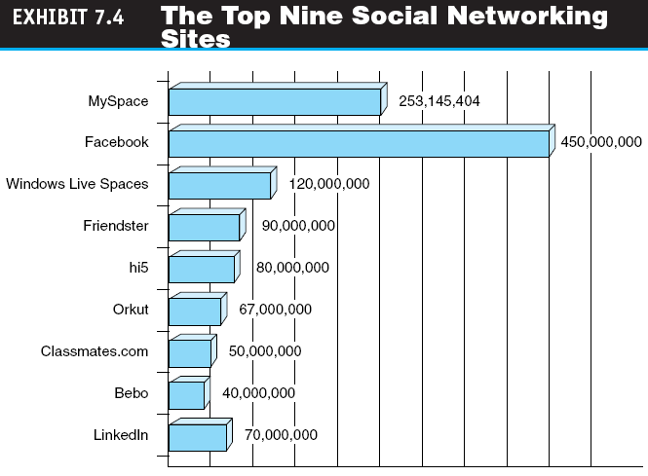

Slide 17
Registered users (in million) of Social Networks 2015

Slide 18
ONLINE SOCIAL NETWORKING: BASICS AND EXAMPLES
social network analysis (SNA)
A software for mapping and measuring of relationships and information flows among people, groups, organizations, computers, and other information- or knowledge-processing entities. The nodes in the network are the people and groups, whereas the links show relationships or flows between the nodes. SNAs provide both visual and a quantitative analysis of relationships.

Slide 19
ONLINE SOCIAL NETWORKING: BASICS AND EXAMPLES
REPRESENTATIVE SOCIAL NETWORKS SITES AND SERVICES
Classmates Online
Xanga (blogs, photoblogs)
Digg (popularity news sharing like hot topics)
mobile social networking
Members converse and connect with one another using cell phones or other mobile devices.
Mobile Enterprise Networks (e.g. coca cola)
Mobile Community Activities

Slide 20
MAJOR SOCIAL NETWORK COMPANIES: FROM FACEBOOK TO FLICKR
FACEBOOK: THE NETWORK EFFECT
BEBO (blog early, blog often) – AOL bought it in 2008
TWITTER IS ALSO FOR BUSINESSES
How Does Twitter Work? (SMS of Internet)
The Key Business Benefits of Twitter
Whatsapp as competitor?
FLICKR (photos) TICKS OFF SOME OF ITS USERS – yahoo acquired in 2005

Slide 21
BUSINESS AND ENTERPRISE SOCIAL NETWORKS
business network
A group of people who have some kind of commercial relationship; for example, sellers and buyers, buyers among themselves, buyers and suppliers, and colleagues and other colleagues.

Slide 22
BUSINESS AND ENTERPRISE SOCIAL NETWORKS
business social network
A social network whose primary objective is to facilitate business connections and activities.

Slide 23
BUSINESS AND ENTERPRISE SOCIAL NETWORKS
The major reasons to use or deploy a business social network are to:
Build better customer relationships
Improve knowledge management
Facilitate recruiting and retention
Increase business opportunities
Build a community
Gain expert advice
Improve trade show experiences
Improve communication and collaboration

Slide 24
BUSINESS AND ENTERPRISE SOCIAL NETWORKS
BUSINESS-ORIENTED SOCIAL NETWORKING
Ryze (similar to LinkedIn)
The Business Social Network
Viadeo (european clone of LinkedIn)
APSense
LinkedIn
Facebook?
Wealink.com (若邻网) in China

Slide 25
BUSINESS AND ENTERPRISE SOCIAL NETWORKS
ENTERPRISE SOCIAL NETWORKS
Allow employees to collaborate and communicate in an employee-driven system
Promote the use of enterprise wikis via demonstrations
Set up internal blogs and incorporate them into internal directories so users can see who has a blog
Set up enterprise social bookmarking systems so users can see what sort of content their colleagues are tagging
CIOs should be involved from the beginning

Slide 26
BUSINESS AND ENTERPRISE SOCIAL NETWORKS
OTHER SOCIAL NETWORKING STRUCTURES
Enterprise 2.0
Technologies and business practices that free the workforce from the constraints of legacy communication and productivity tools such as e-mail. Provides business managers with access to the right information at the right time through a Web of interconnected applications, services, and devices.

Slide 27
BUSINESS AND ENTERPRISE SOCIAL NETWORKS
social marketplace
The term is derived from the combination of social networking and marketplace. An online community that harnesses the power of one’s social networks for the introduction, buying, and selling of products, services, and resources, including one’s own creations. Also may refer to a structure that resembles a social network but is focused on individual members.

Slide 28
COMMERCIAL ASPECTS OF WEB 2.0 AND SOCIAL NETWORKING APPLICATIONS
WHY IS THERE AN INTEREST?
Web 2.0 applications are spreading rapidly, and many of them cater to a specific segment of the population (e.g.,music lovers, travelers, game lovers, and car fans), enabling segmented advertising
Many users of Web 2.0 tools are young, and they will grow older and have more money to spend

Slide 29
COMMERCIAL ASPECTS OF WEB 2.0 AND SOCIAL NETWORKING APPLICATIONS
ADVERTISING USING SOCIAL NETWORKS, BLOGS, AND WIKIS
Viral (Word-of-Mouth) Marketing
viral blogging
Viral (word-of-mouth) marketing done by bloggers.
Classified Ads, Job Listings, and Recruitment
Special Advertising Campaigns
Mobile Advertising

Slide 30
COMMERCIAL ASPECTS OF WEB 2.0 AND SOCIAL NETWORKING APPLICATIONS
SHOPPING IN SOCIAL NETWORKS
FEEDBACK FROM CUSTOMERS: CONVERSATIONAL MARKETING
Customer Feedback with Twitter

Slide 31
COMMERCIAL ASPECTS OF WEB 2.0 AND SOCIAL NETWORKING APPLICATIONS
COMMERCIAL ACTIVITIES IN BUSINESS AND ENTERPRISE SOCIAL NETWORKS
Finding and Recruiting Workers
Management Activities and Support
Training
Knowledge Management and Expert Location
Enhancing Collaboration
Using Blogs and Wikis Inside the Enterprise

Slide 32
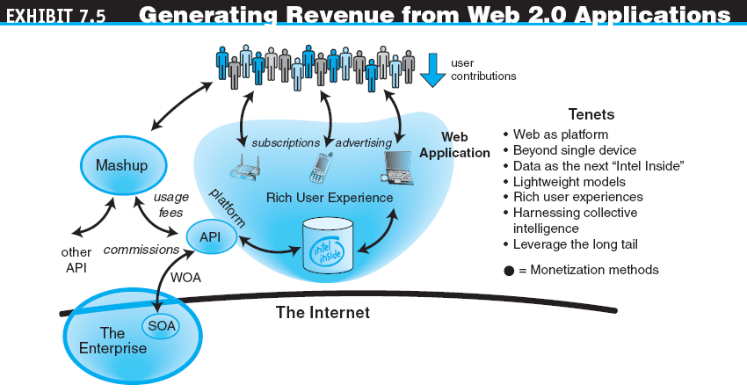

Slide 33
COMMERCIAL ASPECTS OF WEB 2.0 AND SOCIAL NETWORKING APPLICATIONS
REVENUE-GENERATION STRATEGIES IN SOCIAL NETWORKS
Increased Revenue and Its Benefit
RISKS AND LIMITATIONS WHEN INTERFACING WITH SOCIAL NETWORKS
JUSTIFYING SOCIAL MEDIA AND NETWORKING

Slide 34
ENTERTAINMENT WEB 2.0 STYLE: FROM SOCIAL NETWORKS TO MARKETPLACES
ENTERTAINMENT AND SOCIAL NETWORKS
Mixi (Japan)
Last.fm (music)
Pandora (music)
eFans (sports)
Internet Series and Movie Streaming
Adult Entertainment in Virtual Worlds

Slide 35

ENTERTAINMENT WEB 2.0 STYLE: FROM SOCIAL NETWORKS TO MARKETPLACES
MOBILE WEB 2.0 DEVICES FOR ENTERTAINMENT AND WORK
iPhone and Its Clones

Slide 36
THE FUTURE: WEB 3.0 AND WEB 4.0
Web 3.0
A term used to describe the future of the World Wide Web. It consists of the creation of high-quality content and services produced by gifted individuals using Web 2.0 technology as an enabling platform.

Slide 37
THE FUTURE: WEB 3.0 AND WEB 4.0
Semantic Web
An evolving extension of the Web in which Web content can be expressed not only in natural language, but also in a form that can be understood, interpreted, and used by intelligent computer software agents, permitting them to find, share, and integrate information more easily.

Slide 38
THE FUTURE: WEB 3.0 AND WEB 4.0
Web 4.0
The Web generation after Web 3.0. It is still mostly an unknown entity. However, it is envisioned as being based on islands of intelligence and as being ubiquitous.
Future Threats
Security concerns
Lack of Net neutrality (monopolised by big telco with Microsoft, Google)
Copyright complaints
Choppy connectivity

Slide 39
MANAGERIAL ISSUES
How will social networking impact businesses?
Should we explore Web 2.0 collaboration?
Do we need to sponsor a social network?
How should we deal with Web 2.0 risks?
Should we have an in-house social network?

